Slide 1
Chapter 5
Chapter 5
SNMPv1:
Communication and Functional Models
Network Management: Principles and Practice
© Mani Subramanian 2000
5-1

Slide 2
Chapter 5
Communication Model
SNMP Architecture: management messages
Administrative Model: community-based
SNMP Protocol Specifications
SNMP MIB
Notes
Network Management: Principles and Practice
© Mani Subramanian 2000
5-2

Slide 3
Chapter 5
Three Goals of the Architecture
[RFC 1157]
The SNMP explicitly minimizes the number and complexity of management functions realized by the management agent itself. This goal is attractive in at least four respects:
(1) Development cost for agent software is reduced.
(2) & (3) Degree of management function that is remotely supported is increased, thereby:
- admitting fullest use of internet resources in the management task.
- imposing the fewest possible restrictions on the form and sophistication of management tools.
(4) Simplified sets of management functions are easily understood and used by developers of network management tools.
The functional paradigm for monitoring and control must be sufficiently extensible to accommodate additional, possibly unanticipated aspects of network operation and management.
The architecture must be, as much as possible, independent of the architecture and mechanisms of particular hosts or particular gateways.
5-3

Slide 4
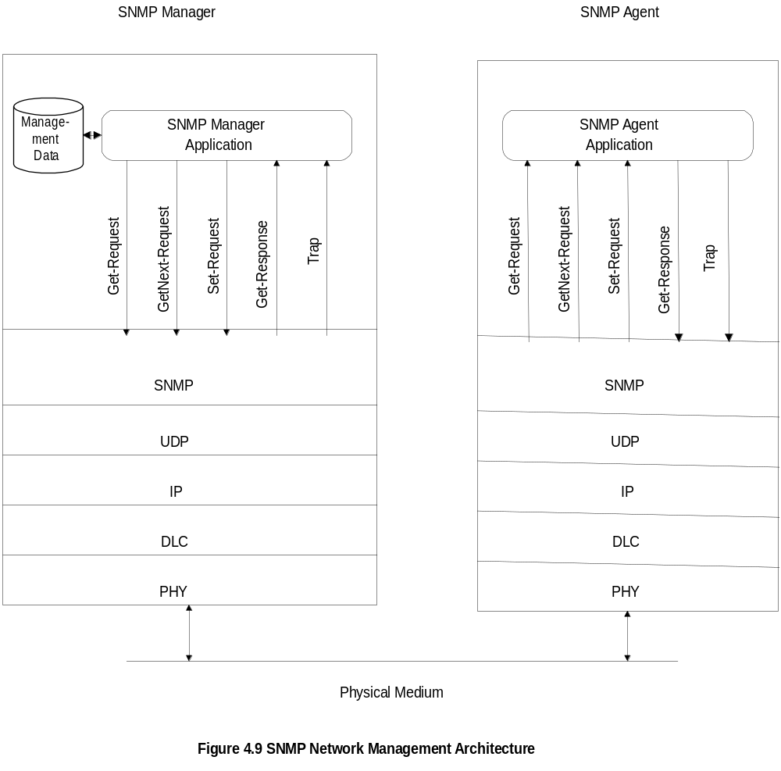
Chapter 5
SNMP Architecture
Notes
Truly simple network management protocol
Five messages, three from manager and two from agent
Network Management: Principles and Practice
© Mani Subramanian 2000
5-4

Slide 5
Chapter 5
Data Transfer
Only non-aggregate objects are communicated using SNMP
Aggregate objects are communicated as instances of objects.
This was enhanced in SNMPv2
ASN.1 and BER are used for data transfer in SNMP
Notes
Network Management: Principles and Practice
© Mani Subramanian 2000
5-5

Slide 6
Chapter 5
SNMP Messages
Get-Request
Get-Next-Request
Set-Request
Get-Response
Trap
  Generic trap
  Specific trap
  Time stamp
Notes
Generic trap
  coldStart
  warmStart
  linkDown
  linkUp
  authenticationfailure
  egpNeighborLoss
  enterpriseSpecific
Specific trap
  for special measurements such as statistics
Time stamp: Time since last initialization
Network Management: Principles and Practice
© Mani Subramanian 2000
5-6

Slide 7
Chapter 5
Administrative Model
Based on community profile and policy
SNMP Entities:
  SNMP application entities
  - Reside in management stations and network
  elements
  - Manager and agent
  SNMP protocol entities
  - Communication processes (PDU handlers)
  - Peer processes that support application entities
Notes
Network Management: Principles and Practice
© Mani Subramanian 2000
5-7

Slide 8
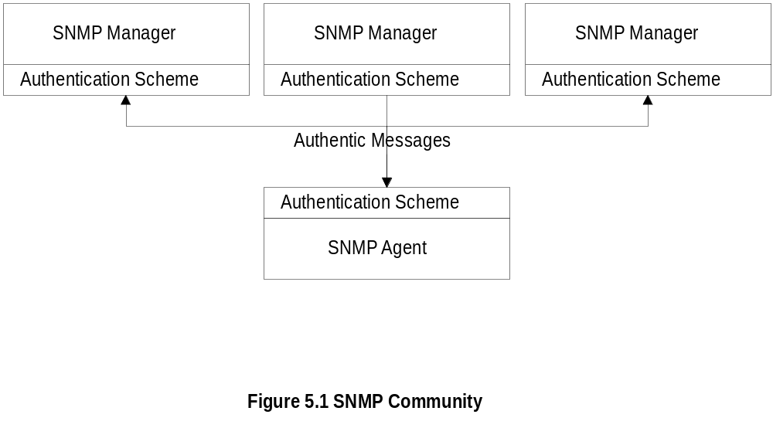
Chapter 5
SNMP Community
Notes
Security in SNMPv1 is community-based
Authentication scheme in manager and agent
Community: Pairing of two application entities
Multiple pairs can belong to the same community
Community name: String of octets
Two applications in the same community
communicate with each other
Application could have multiple community names
Communication is not secured in SNMPv1 - no
encryption
Network Management: Principles and Practice
© Mani Subramanian 2000
5-8

Slide 9
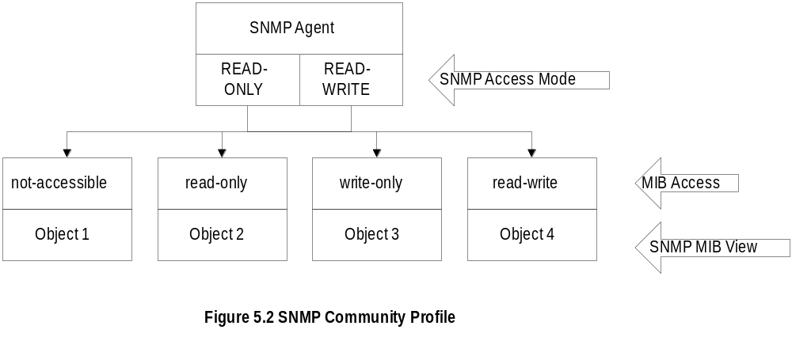
Chapter 5
Community Profile
Notes
MIB view
  An agent is programmed to view only a subset
  of managed objects of a network element
Access mode
  Each community name is assigned an access
  mode: read-only and read-write
Community profile= MIB view + Access mode
Operations on an object determined by community
profile and the access mode of the object
Total of four access privileges
Some objects, such as table and table entry are
non-accessible
Network Management: Principles and Practice
© Mani Subramanian 2000
5-9

Slide 10
Chapter 5
Administrative Model
Administrative model is SNMP access policy
SNMP community paired with SNMP
community profile is SNMP access policy
Notes
Parameters:
Community / communities
Agent / Agents
Manager / managers
Network Management: Principles and Practice
© Mani Subramanian 2000
5-10

Slide 11
Chapter 5
Administrative Model
Summary & Example
Access policy = Community + Community profile
Community profile = Access mode + MIB view
Example:
SNMP community is “public”
SNMP access mode is “READ-ONLY”
MIB view is the “system” MIB sub-tree
SNMP community profile = (“system”, “READ-ONLY”)
SNMP access policy = (“public”, (“system”, “READ-ONLY”))
The sysLocation MIB object has read-write access.
With this SNMP access policy, the manager can only get information from the sysLocation object, and can not set it.
Notes
5-11

Slide 12
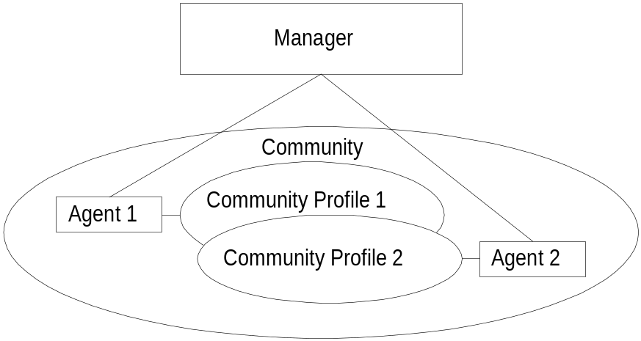
Chapter 5
Access Policy
Notes
Manager manages Community 1 and 2 network
components via Agents 1 and 2
Agent 1 has only view of Community Profile 1,
e.g. Cisco components
Agent 2 has only view of Community Profile 2,
e.g. 3Com components
Manager has total view of both Cisco and 3Com
components
Network Management: Principles and Practice
© Mani Subramanian 2000
5-12

Slide 13
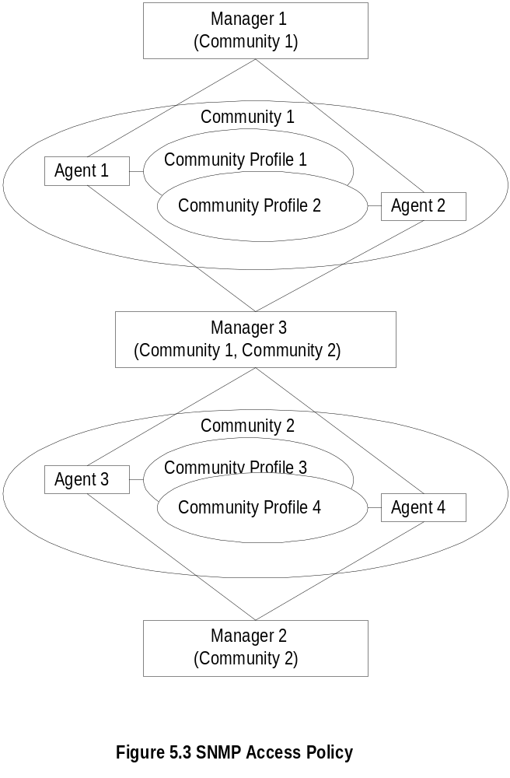
Chapter 5
Generalized Administration Model
Notes
Manager 1 manages community 1, manager 2
community 2, and manager 3 (MoM) both communities
1 and 2
Network Management: Principles and Practice
© Mani Subramanian 2000
5-13

Slide 14
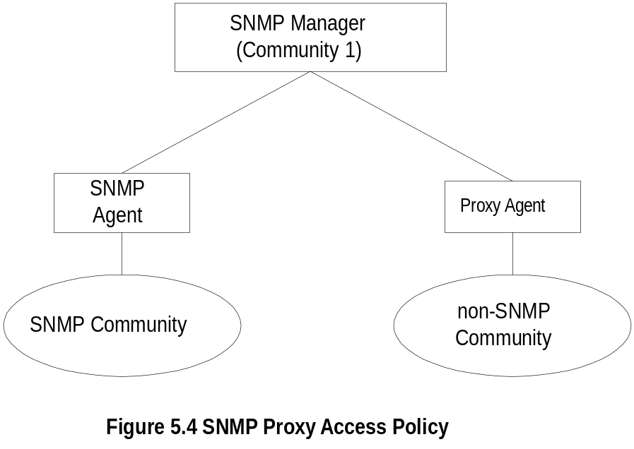
Chapter 5
Proxy Access Policy
Notes
Access policy can be extended to managing non-SNMP community
Proxy agent enables non-SNMP community
elements to be managed by an SNMP manager.
Proxy agent monitors non-SNMP community, and converts objects and data to SNMP compatible objects.
An SNMP MIB is created to handle the non-SNMP
objects
Network Management: Principles and Practice
© Mani Subramanian 2000
5-14

Slide 15
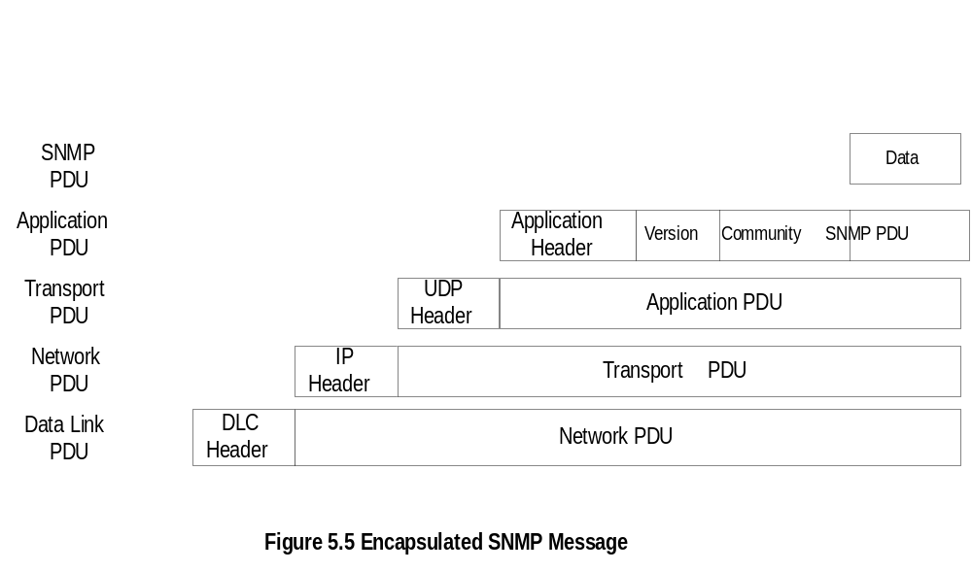
Chapter 5
Protocol Entities
Notes
Protocol entities support application entities
Communication between remote peer processes
SNMP Message consists of
  Version identifier
  Community name
  Protocol Data Unit
Message encapsulated and transmitted
In SNMPv1, it is mandatory to support all 5 PDUs
SNMP uses UDP port 161 for get & set, and UDP
port 162 for traps.
Network Management: Principles and Practice
© Mani Subramanian 2000
5-15

Slide 16
Chapter 5
Top-level SNMP Message
[RFC 1157]
Message ::=
SEQUENCE {
version -- version-1 for this RFC
INTEGER {
version-1(0)
},
community -- community name
OCTET STRING,
data -- e.g., PDUs if trivial
ANY -- authentication is being used
}
Notes
Network Management: Principles and Practice
© Mani Subramanian 2000
5-16

Slide 17
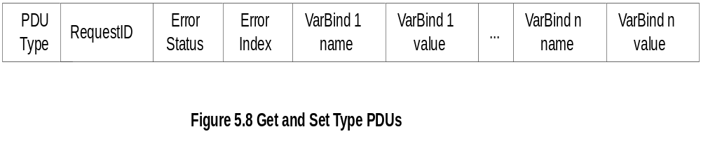
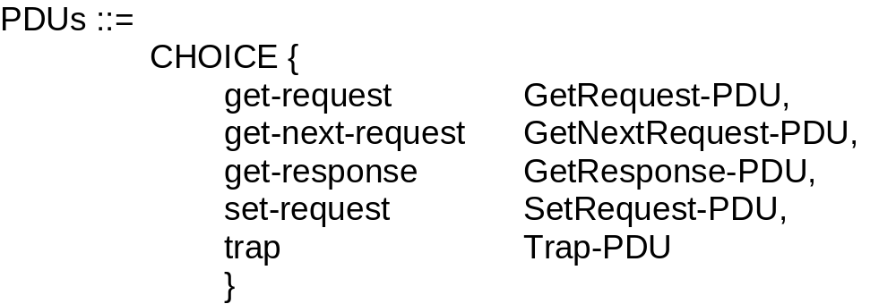

Chapter 5
Get and Set PDU
Notes
VarBindList: multiple instances of VarBind pairs
PDU Types: Application data types
Network Management: Principles and Practice
© Mani Subramanian 2000
5-17

Slide 18
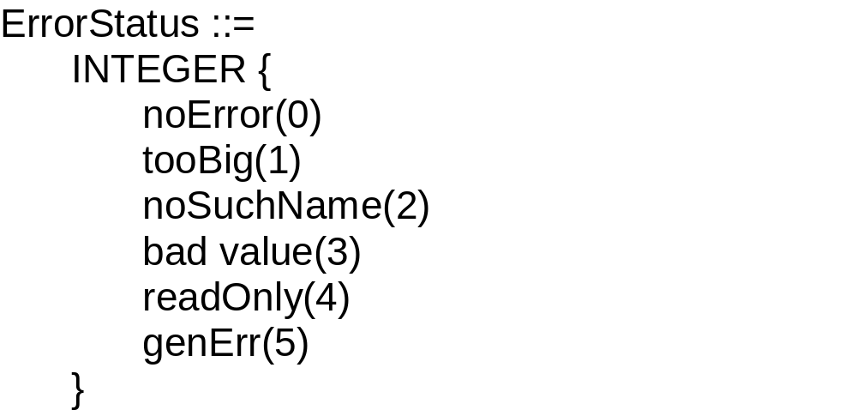
Chapter 5
Error in Response
Error Index: No. of VarBind where the first error occurred
Notes
Network Management: Principles and Practice
© Mani Subramanian 2000
5-18

Slide 19
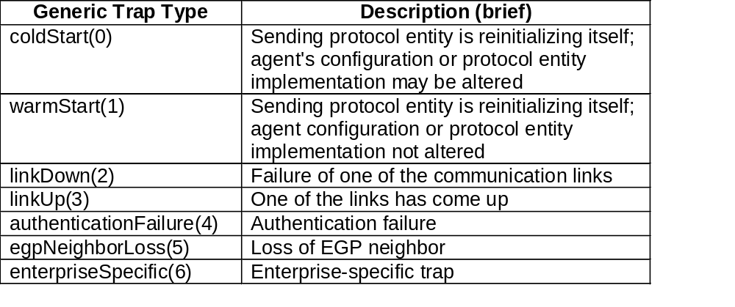
Chapter 5
Trap PDU
Notes
Enterprise and agent address pertain to the system
generating the trap
Seven generic traps specified by enumerated
INTEGER
enterpriseSpecific(6) trap signifies that an enterprise-specific event has occurred. The specific-trap field identifies the particular trap which occurred.
Timestamp indicates elapsed time since last re-
initialization
Network Management: Principles and Practice
© Mani Subramanian 2000
5-19

Slide 20
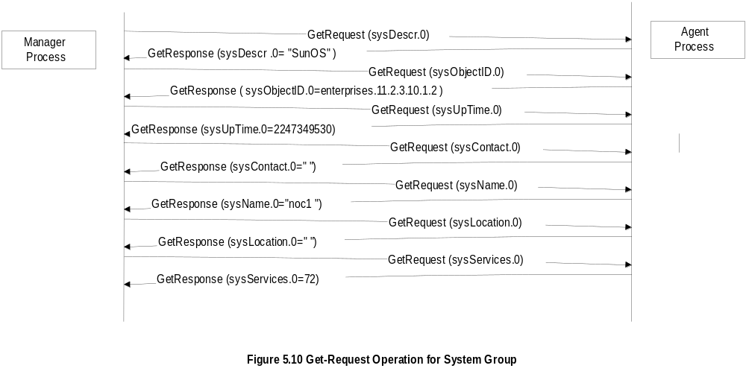
Chapter 5
SNMP Operations
Notes
Requires seven get-request messages.
Same information could be obtained in one message with multiple varbinds.
Requires knowledge of all elements to be requested by name or OID.
Network Management: Principles and Practice
© Mani Subramanian 2000
5-20

Slide 21
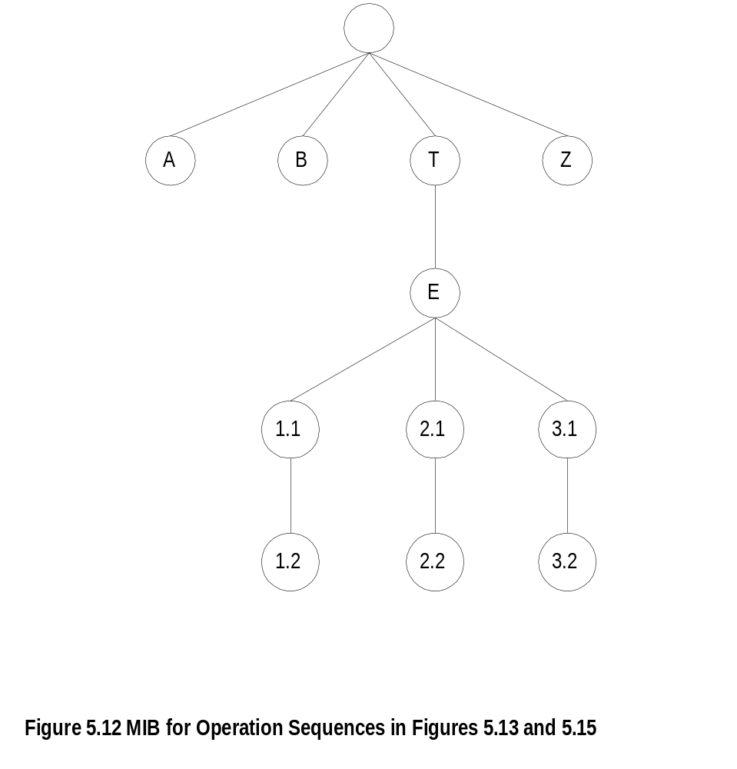
Chapter 5
MIB for Get-Next-Request
Notes
For aggregate objects, we need to know the number of rows and columns if we use GetRequest messages to get all the instances of a table → Use of GetNextRequest
Network Management: Principles and Practice
© Mani Subramanian 2000
5-21

Slide 22
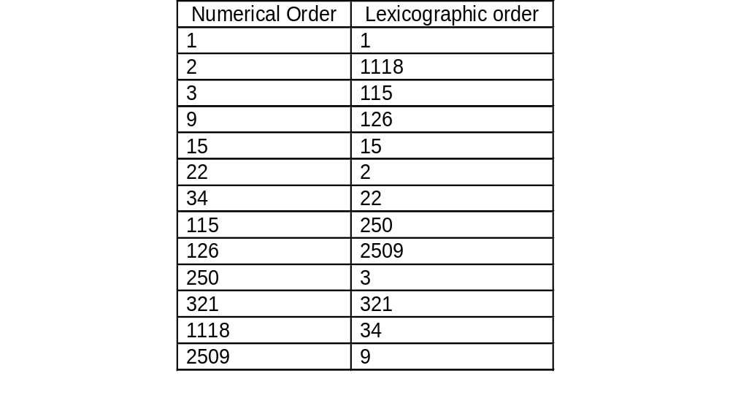
Chapter 5
Lexicographic Order
Notes
Procedure for ordering:
  Start with leftmost digit as first position
  Before increasing the order in the first position,
  select the lowest digit in the second position
  Continue the process till the lowest digit in
  the last position is captured
  Increase the order in the last position until all
  the digits in the last position are captured
  Move back to the last but one position and
  repeat the process
  Continue advancing to the first position until all
  the numbers are ordered
Tree structure for the above process
Network Management: Principles and Practice
© Mani Subramanian 2000
5-22

Slide 23
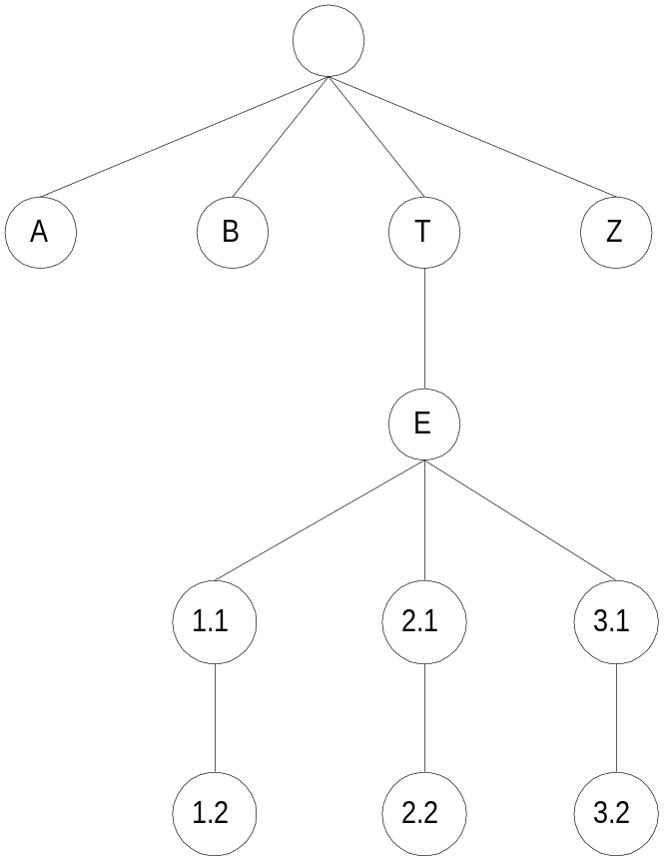
Chapter 5
MIB Lexicographic Order
Notes
A 3.1
B 3.2
T Z
E
1.1
1.2
2.1
2.2
Network Management: Principles and Practice
© Mani Subramanian 2000
5-23

Slide 24
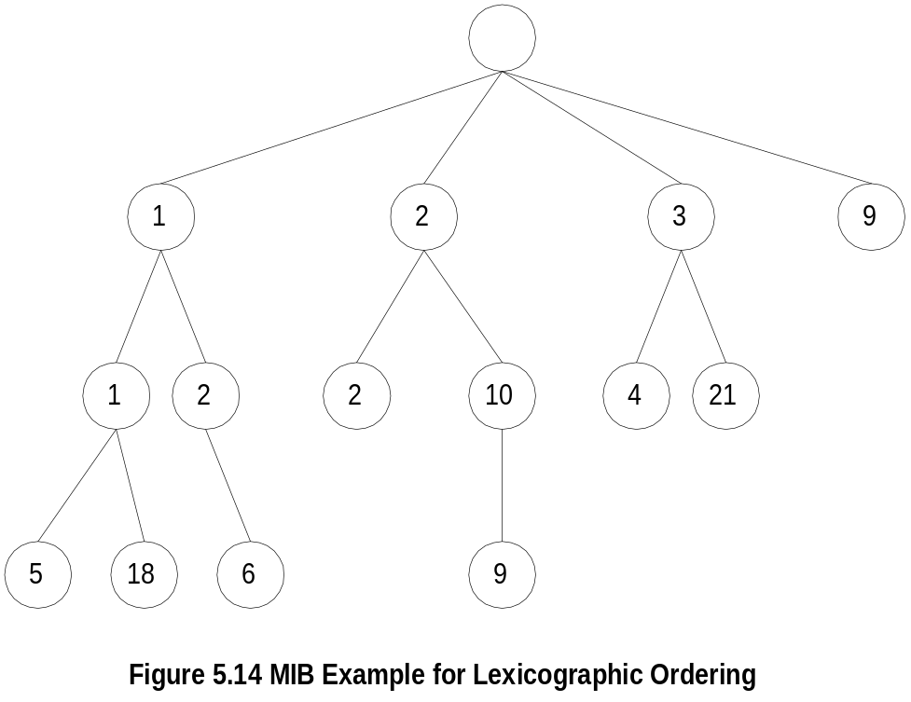
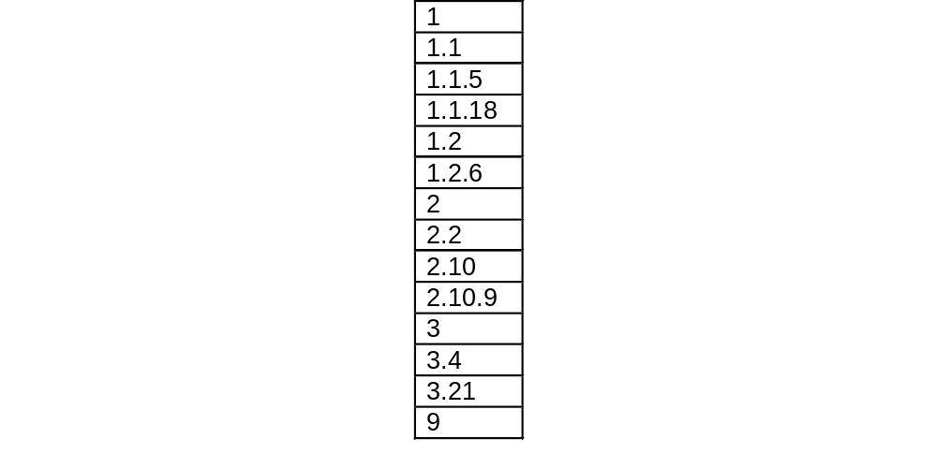
Chapter 5
A More Complex MIB Example
Notes
Network Management: Principles and Practice
© Mani Subramanian 2000
5-24

Slide 25
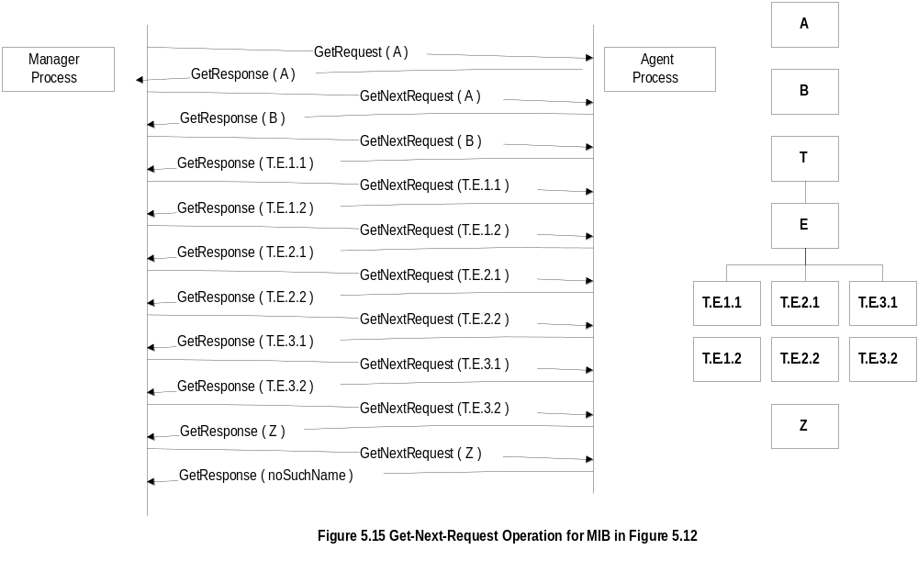
Chapter 5
Get-Next-Request Operation
Notes
No need to know next OID
Table instances are retrieved without knowledge of number of rows
Can be used to browse a MIB tree (e.g., MIB walk, MIB browsers)
Network Management: Principles and Practice
© Mani Subramanian 2000
5-25

Slide 26
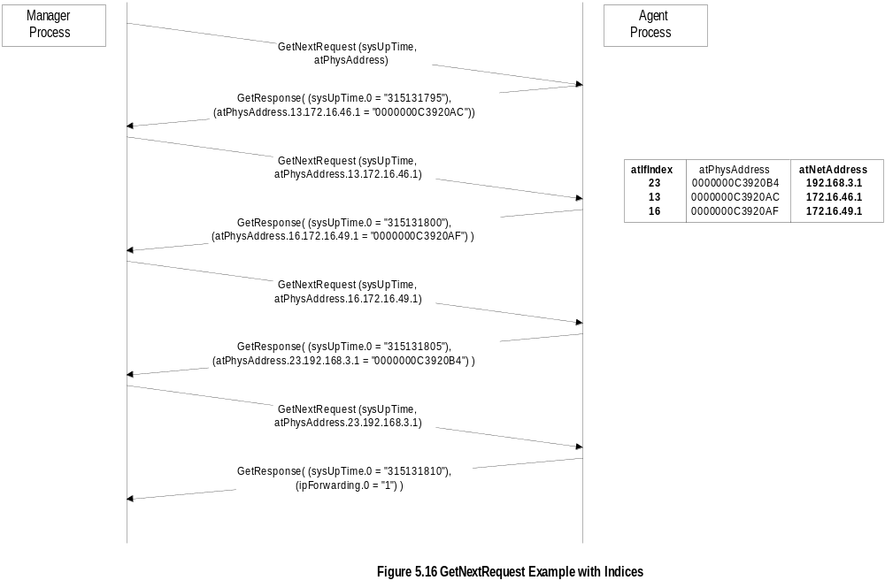
Chapter 5
Get-Next-Request Operation
Notes
Use of basic GetNextRequest → 10 Request messages.
Varbind could be expanded and more values about the same row could be obtained in one request → 4 Request messages.
Network Management: Principles and Practice
© Mani Subramanian 2000
5-26

Slide 27
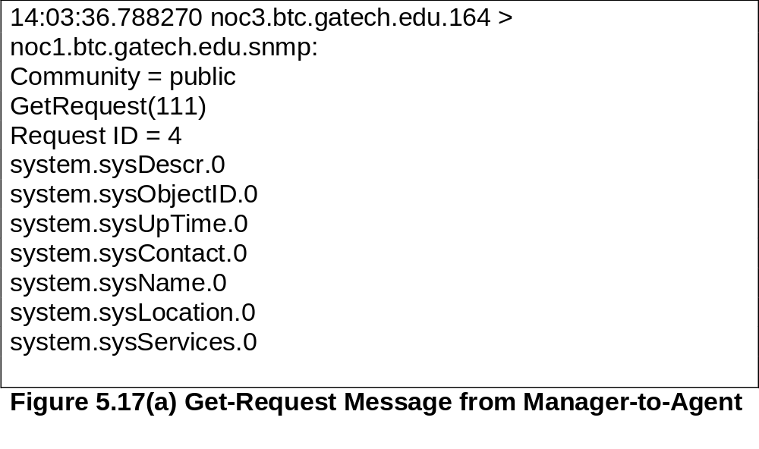
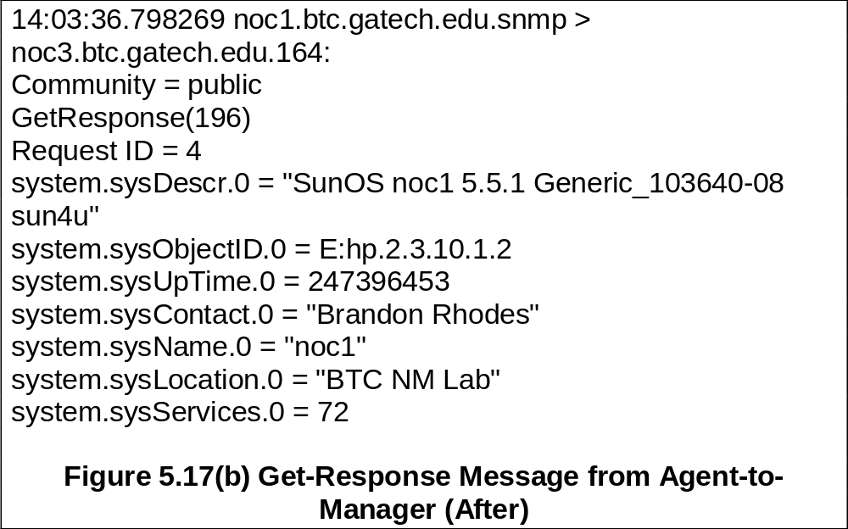
Chapter 5
Sniffer Data
Network Management: Principles and Practice
© Mani Subramanian 2000
5-27

Slide 28
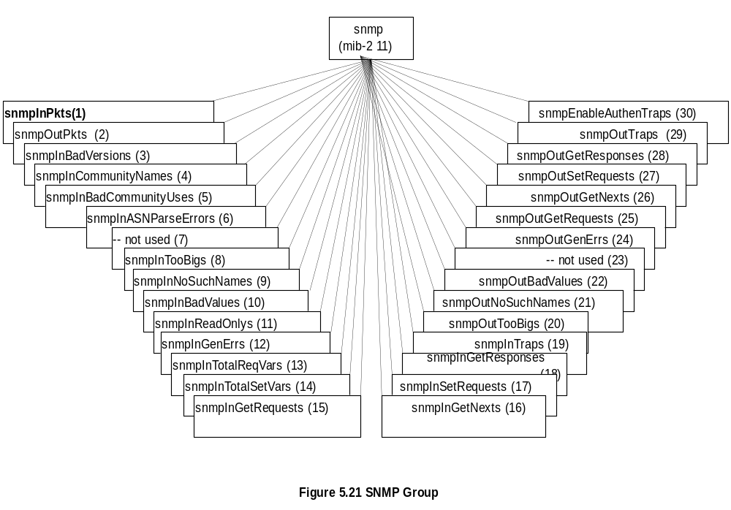
Chapter 5
SNMP MIB
Note: Most of the MIB objects were not used and hence deprecated in SNMPv2
Network Management: Principles and Practice
© Mani Subramanian 2000
5-28

Slide 29
Chapter 5
Functional Model
No formal specifications of functions in SNMPv1 management.
Application functions limited to network management and not to services provided.
Configuration management:
  Some configuration functions are addressed in SNMP protocol entity specifications.
  Example: Set configurable parameters (requires write access)
Fault management:
  Addressed by error counters built into agents.
  Traps used to monitor network elements and interfaces going up and down.
Performance management:
  Performance counters.
  SNMP manager does the performance analysis.
Security management:
  Some security/privacy-related issues addressed in SNMP protocol entity specifications.
  Security functions partially addressed by community specifications and authentication scheme.
Accounting management:
  Not addressed by SNMP model
Network Management: Principles and Practice
© Mani Subramanian 2000
5-29

